Slide 1
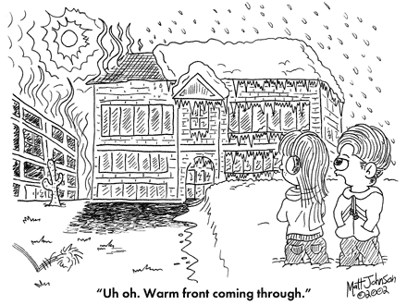
Air Masses and Fronts
Science 6th Grade

Slide 2
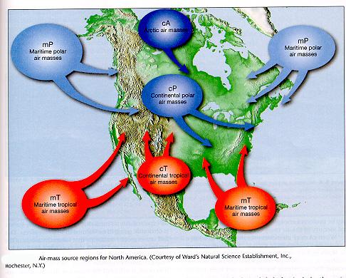
Air Mass
A large body of air with similar temperature, humidity, and air pressure.
Air masses form over large land or water masses.
MAP TAP 2002-2003
Weather Fronts

Slide 3
Whether an air mass is warm or cold depends on the temperature over which the mass forms.
4 types of air masses
Tropical – warm air masses that form over the tropics.
Polar – cold air masses that form over the poles.
Maritime – air masses that form over the ocean (very humid)
Continental – form over land – (are dry)
MAP TAP 2002-2003
Weather Fronts

Slide 4
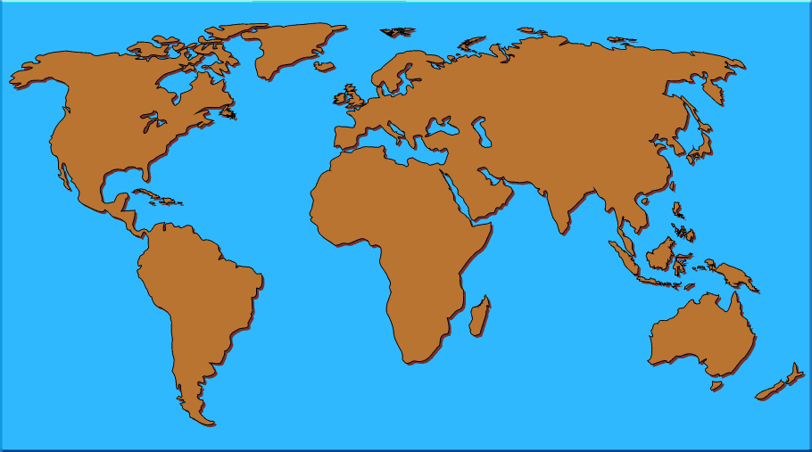
Continental -
Means land.
A Continental air mass forms over land.
Weather Fronts

Slide 5

Maritime -
Means water.
Maritime air masses form over water.
MAP TAP 2002-2003
Weather Fronts

Slide 6
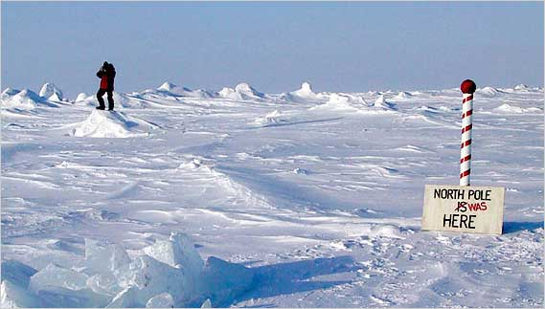
Polar
Polar means it forms over the poles.
COLD!
MAP TAP 2002-2003
Weather Fronts

Slide 7
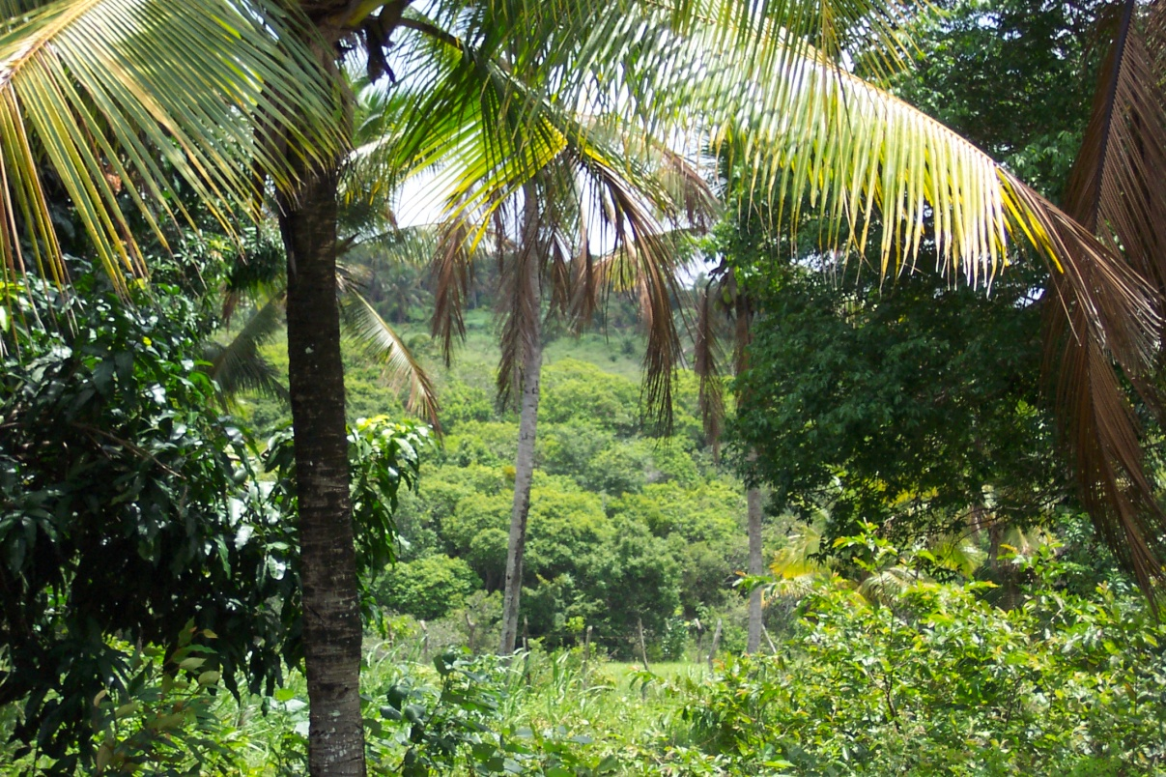
Tropical
Form over the tropics (near the equator)
WARM!!
MAP TAP 2002-2003
Weather Fronts

Slide 8
MAP TAP 2002-2003
Weather Fronts

Slide 9
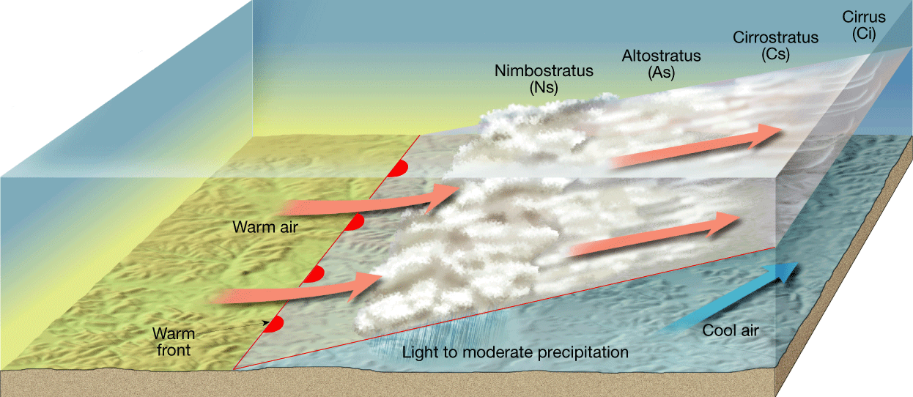
Fronts
Where air masses meet but do not mix due to different temperatures and densities. becomes a front
MAP TAP 2002-2003
Weather Fronts

Slide 10
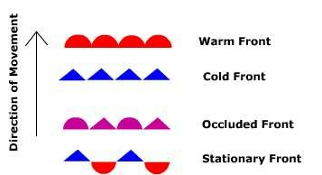
Fronts
4 kinds of fronts:
  Cold front
  Warm front
  Occluded front
  Stationary front
MAP TAP 2002-2003
Weather Fronts

Slide 11
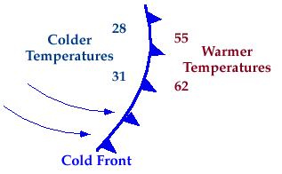
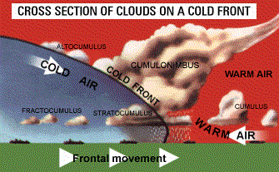
Cold Front
A cold air mass is replacing a warmer air mass.
Shown on a weather map by a blue line with triangles pointing the direction the cool air is moving.

Slide 12
Cold Front
Rapidly moving cold air mass runs into a slowly moving warm air mass.
The denser cold air slides under the lighter warm air pushing it upward.
The rising air cools and condenses, forming clouds.
Heavy rain or snow may fall.
If the warm air mass contains only a little water vapor, there may be only cloudy skies.
MAP TAP 2002-2003
Weather Fronts

Slide 13
Cold Front
Cold fronts move quickly and can cause abrupt weather changes including violent thunderstorms
After a cold front passes through, cool, dry air moves in.
Clear skies and cooler temperatures often follow.
MAP TAP 2002-2003
Weather Fronts

Slide 14
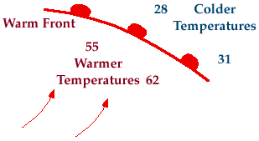
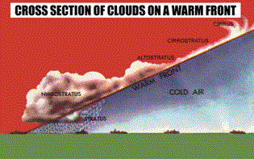
Warm Front
Warm air mass collides with a slowly moving cooler air mass.
Shown on a weather map by a red line with half circles pointing the direction the warm air is moving.
MAP TAP 2002-2003
Weather Fronts

Slide 15
Warm Front
Moving warm air mass collides with a slowly moving cold air mass.
The warm air moves over the denser cold air.
If the warm air is humid, showers and light rain fall along the front where the warm and cold air meet.
If the warm air is dry scattered clouds form.
MAP TAP 2002-2003
Weather Fronts

Slide 16
Warm Front
Because warm fronts move more slowly than cold fronts, the weather may be rainy or foggy for several days.
After the warm front passes, the weather is likely to be warm and humid.
In winter, warm fronts bring snow.
MAP TAP 2002-2003
Weather Fronts

Slide 17
Comparing Warm and Cold Fronts
Cold fronts move faster than warm fronts.
The weather activity in a cold front is often violent and happens directly at the front.
Cold fronts have sudden gusty winds high in the air creating turbulence.
The weather activity in a warm front generally happens before the front passes.
In a warm front the cloud formation is very low often creating situations of poor visibility.
MAP TAP 2002-2003
Weather Fronts

Slide 18
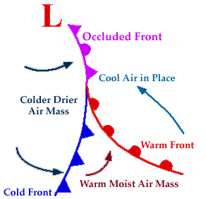
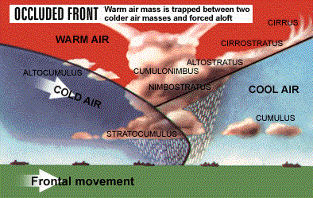
Occluded Fronts
When a warm front is trapped by 2 cold fronts.
Shown on a weather map by a purple line with alternating triangles and semicircles pointing the direction the front is moving.
MAP TAP 2002-2003
Weather Fronts

Slide 19
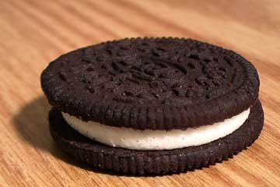
Occluded Fronts
A warm air mass is caught between two cooler air masses.
The denser cool air masses move underneath the less dense warm air and push it upward.
The temperature near the ground becomes cooler.
MAP TAP 2002-2003
Weather Fronts

Slide 20
Occluded Fronts
The warm air mass is cut off, or occluded, from the ground.
As the warm air cools and its water vapor condenses, the weather may turn cloudy and rainy or snowy.
MAP TAP 2002-2003
Weather Fronts

Slide 21
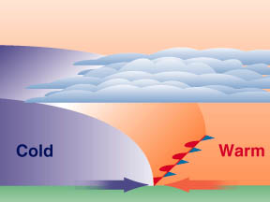
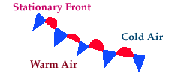
Stationary Fronts
A front that stops moving or is moving very slowly.
Shown on a weather map with alternating red semicircles pointing away from the warm air and blue triangles pointing away from the cold air.
MAP TAP 2002-2003

Slide 22
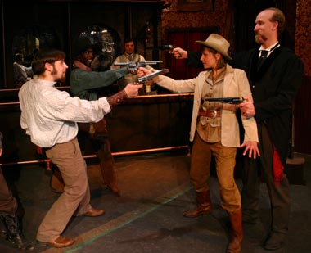
Stationary Fronts
Sometime cold and warm air masses meet, but neither has enough force to move the other.
They meet in a “standoff”
MAP TAP 2002-2003
Weather Fronts

Slide 23
Stationary Fronts
Where the warm and cool air meet, water vapor in the air condenses into rain, snow, fog, or clouds.
It may stall over an area and bring many days of clouds and precipitation.
MAP TAP 2002-2003
Weather Fronts

Slide 24
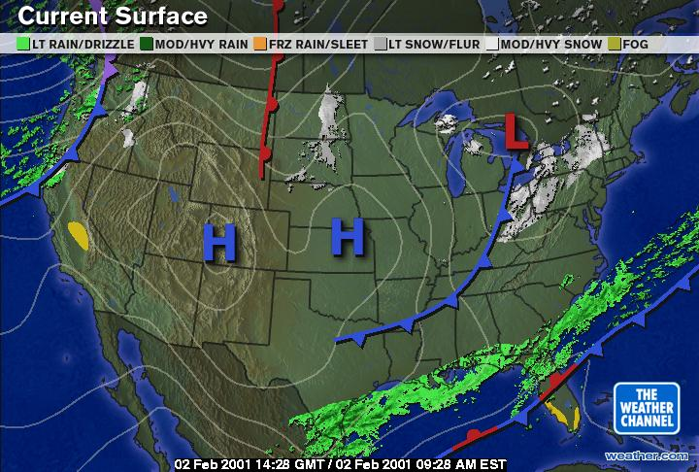
Locate the 4 types of fronts on this weather map.

Slide 25
Cold Fronts

Slide 26
Warm Front

Slide 27
Stationary Front

Slide 28
Occluded Front

Slide 29
Be a Weather Forecaster
You are planning to travel to Alabama in 2 days. The high temperature there for today is 68º F.
Use the map to help you predict whether the temperature in Alabama will increase, decrease, or stay the same. Explain why you think so.
Weather Fronts

Slide 30
Be a Weather Forecaster
There is a cold front approaching. The temperatures will probably be cooler behind the front.

Slide 31

Be a Weather Forecaster
Of course, meteorologists (weather forecasters) use much more data than fronts and air masses to help them forecast the weather more accurately. But any forecast is just a prediction of what might happen. Even with the best data, weather forecasts can be wrong.
MAP TAP 2002-2003
Weather Fronts

